Slide 1

The Role of Artificial Intelligence and Machine Learning in Cloud Platforms
Presented by:
NIVASINI VM (192511356)
CSA1511 :CLOUD COMPUTING AND BIG DATA ANALYTICS
Date: 17/07/2026
Technical Presentation

Slide 2


INTRODUCTION
Artificial Intelligence (AI) enables computers to perform tasks that normally require human intelligence.
Machine Learning (ML) is a subset of AI that allows systems to learn from data and improve automatically.
Cloud platforms provide computing power, storage, and AI tools over the internet.
Combining AI/ML with cloud computing enables scalable, cost-effective, and intelligent applications.

Slide 3
Core Technical Explanation
AI/ML Workflow in Cloud Platforms
1. Data Collection
Collect data from IoT devices, sensors, websites, mobile apps, and databases.
2. Cloud Storage
Store large datasets securely using cloud storage services.
3. Data Processing
Clean, transform, and prepare data for machine learning.
4. Model Training
Train ML models using cloud CPUs, GPUs, or TPUs.
5. Model Evaluation
Test the model for accuracy and optimize performance.
6. Model Deployment
Deploy the trained model as a cloud service or API.

Slide 4
AI/ML Cloud Architecture
Data Sources
↓
Cloud Storage
↓
Data Processing
↓
Machine Learning Model
↓
Model Deployment
↓
Applications & Users
Components
Data Collection
Cloud Storage
Data Processing
Model Training
Model Deployment
Monitoring

Slide 5
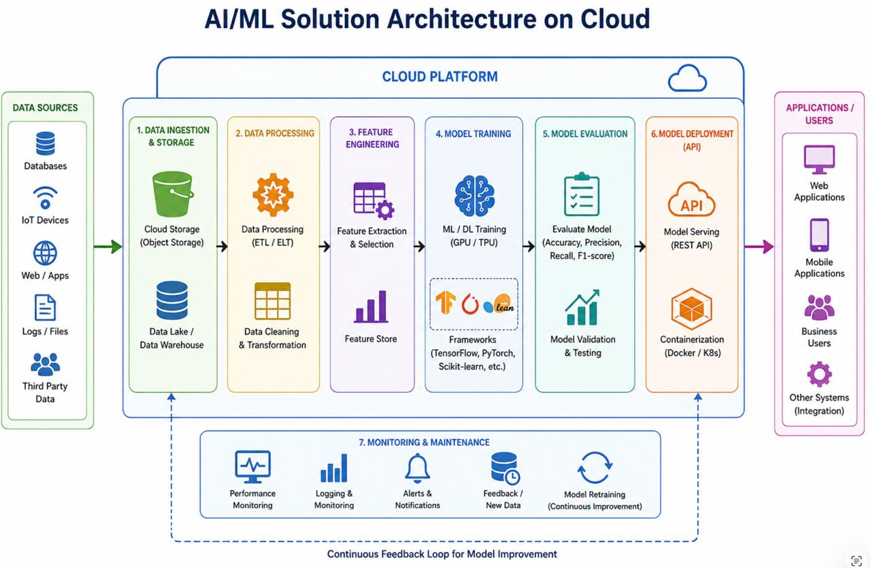

Slide 6
Benefits of AI/ML in Cloud Platforms
Advantages
Scalable computing resources
Reduced infrastructure cost
Faster model development
High-performance GPUs and TPUs
Easy deployment of AI applications
Automatic updates and maintenance
Better collaboration among teams

Slide 7
Real-World Applications
Healthcare
Disease diagnosis
Medical image analysis
Patient monitoring
Banking & Finance
Fraud detection
Credit scoring
Risk analysis
Retail & E-Commerce
Product recommendations
Customer behavior analysis
Demand forecasting
Manufacturing
Predictive maintenance
Quality inspection
Process automation
Transportation
Traffic prediction
Route optimization
Autonomous driving support
Education
Personalized learning
AI-based tutoring
Automated grading

Slide 8
Use Case – AI-Based Fraud Detection
Problem
Millions of online transactions occur every day.
Manual fraud detection is slow and inaccurate.
AI/ML Cloud Solution
Customer initiates an online transaction.
Transaction data is uploaded to the cloud.
AI/ML model analyzes transaction patterns.
Suspicious transactions are identified instantly.
Bank approves or blocks the transaction.

Slide 9
Conclusion
AI and Machine Learning are transforming cloud platforms by enabling intelligent, data-driven applications.
Cloud-based AI/ML services provide scalable, secure, and cost-effective solutions for businesses.
Industries such as healthcare, banking, retail, manufacturing, and education benefit from AI-powered automation and decision-making.
AI/ML in the cloud improves efficiency, accuracy, and real-time insights while reducing operational costs.
As cloud technology continues to evolve, AI and ML will play a key role in driving innovation and digital transformation across industries.

Slide 10
Limitations
Data privacy and security concerns.
High cost of training large AI models.
Dependence on a stable internet connection.
Large datasets require significant storage and bandwidth.
AI models may produce biased or inaccurate results.
Compliance with data protection regulations can be challenging.
Requires skilled professionals to develop and manage AI solutions.

Slide 11
FUTURE SCOPE
Growth of Generative AI for content creation and automation.
Increased adoption of Edge AI with cloud integration.
Wider use of AutoML for automated model development.
Expansion of Explainable AI (XAI) for transparent decision-making.
Improved cloud security using AI-powered threat detection.
Greater adoption across healthcare, finance, education, and smart cities.
Integration with IoT, 5G, and Big Data for real-time intelligent applications.

Slide 12
Thank You!!!

